Slide 1
Navigating Church Management Software
A webinar presented by:
Jonathan Smith
IT Director, Faith Ministries, and Owner, MBS Inc.
Matthew Branaugh Attorney and Editor, Church Law & Tax

Slide 2
The Best ChMS…

Slide 3
The Best ChMS is…
The one you already own
Training before changing
Don’t start with the subjective
“It’s easier.”
“It’s more user-friendly.”
“It’s better.”
“It has a more modern look and feel.”
“I used it at my last ministry, and everything was great.”

Slide 4
The Best ChMS is…
Objective metrics
Attendance increases by a specific percentage.
Giving increases by a specific dollar amount.
A process that once took 20 minutes now takes five minutes.
Data is more easily shared among leaders, so a single follow-up with a first-time guest that used to take 30 minutes is now a 10-minute process wherein the guest is contacted four times by ministries relevant to his or her needs.
Servant retention grows by a specific percentage.

Slide 5
The Best ChMS is…
How to shop
Does the provider offer support on the weekends?
Does that support cost extra?
Do they offer (and do you need) phone support?
What is the turnaround time for customization?
Do they have a roadmap, and is it attainable?
Are they constantly promising that a feature you need is ‘coming soon’?

Slide 6
The Best ChMS is…
80/20 Rule

Slide 7
The Best ChMS is…
Objective evaluation
What are the objective “pain points” you contend with today, that you’re looking to solve with new software?
What are the specific objectives you seek to accomplish with the software?

Slide 8
The Best ChMS is…
Objective evaluation
What are all the different software applications and platforms you use now to accomplish those objectives?
How does your current solution address your specific needs?
How does a potential new solution address your specific needs?

Slide 9
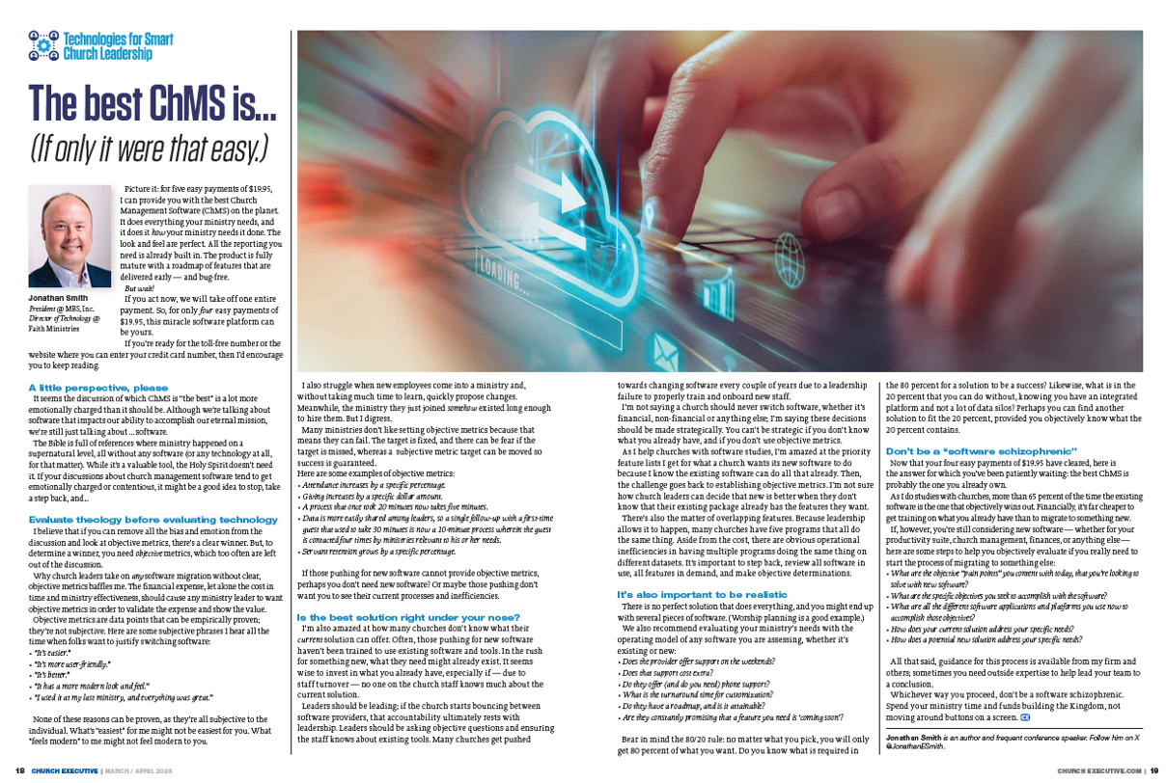

Slide 10
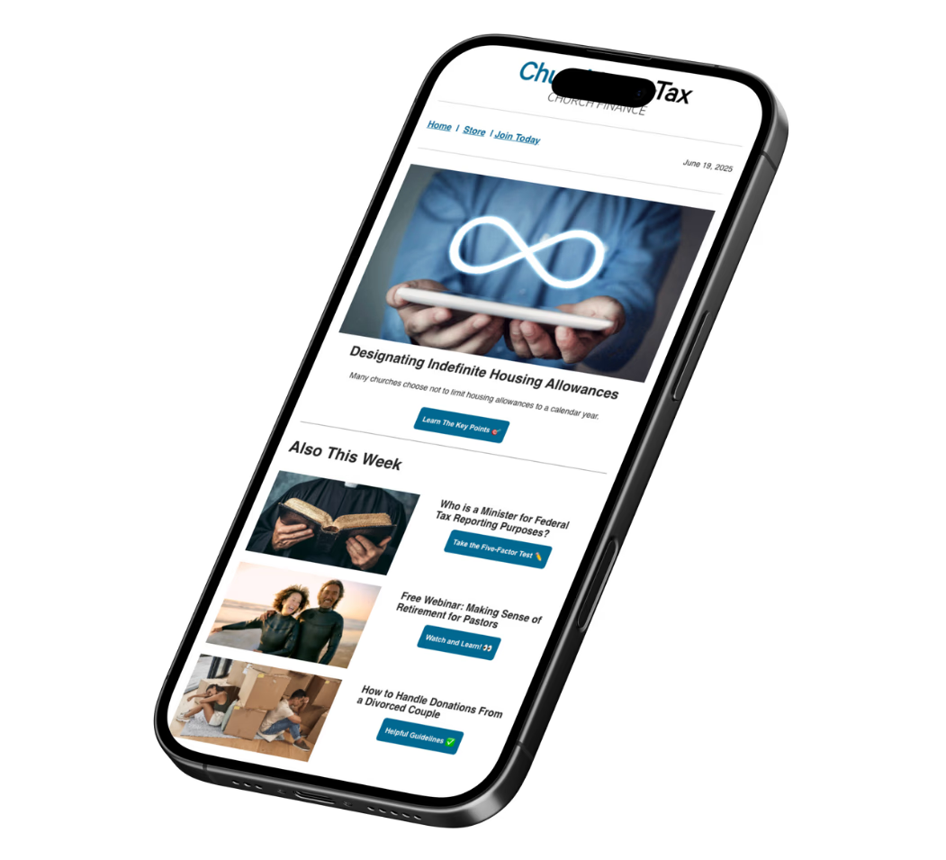
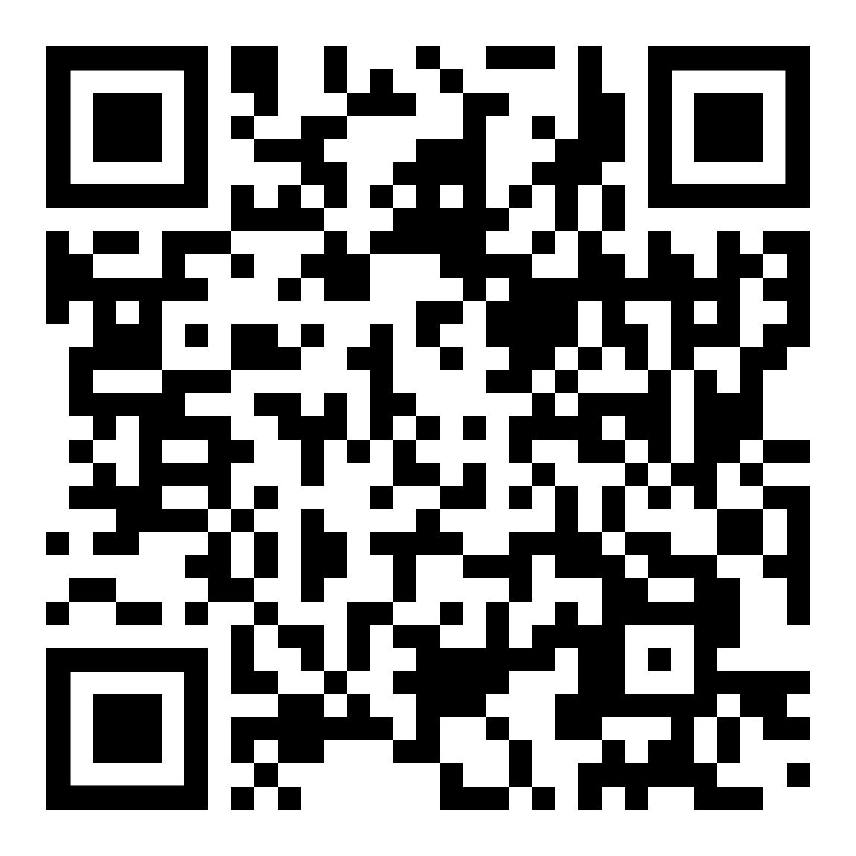
Stay Informed
Join the FREE Church Law & Tax Newsletter for trusted guidance, relevant updates, and exclusive insights, every week.

Slide 11
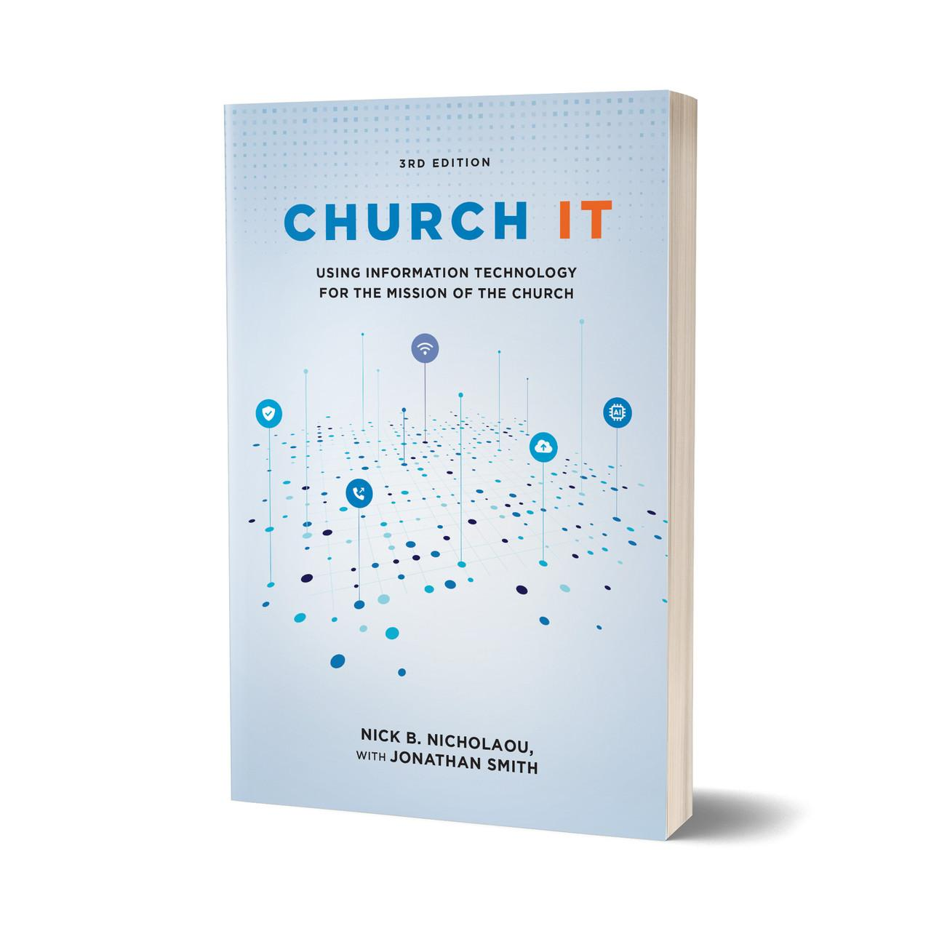
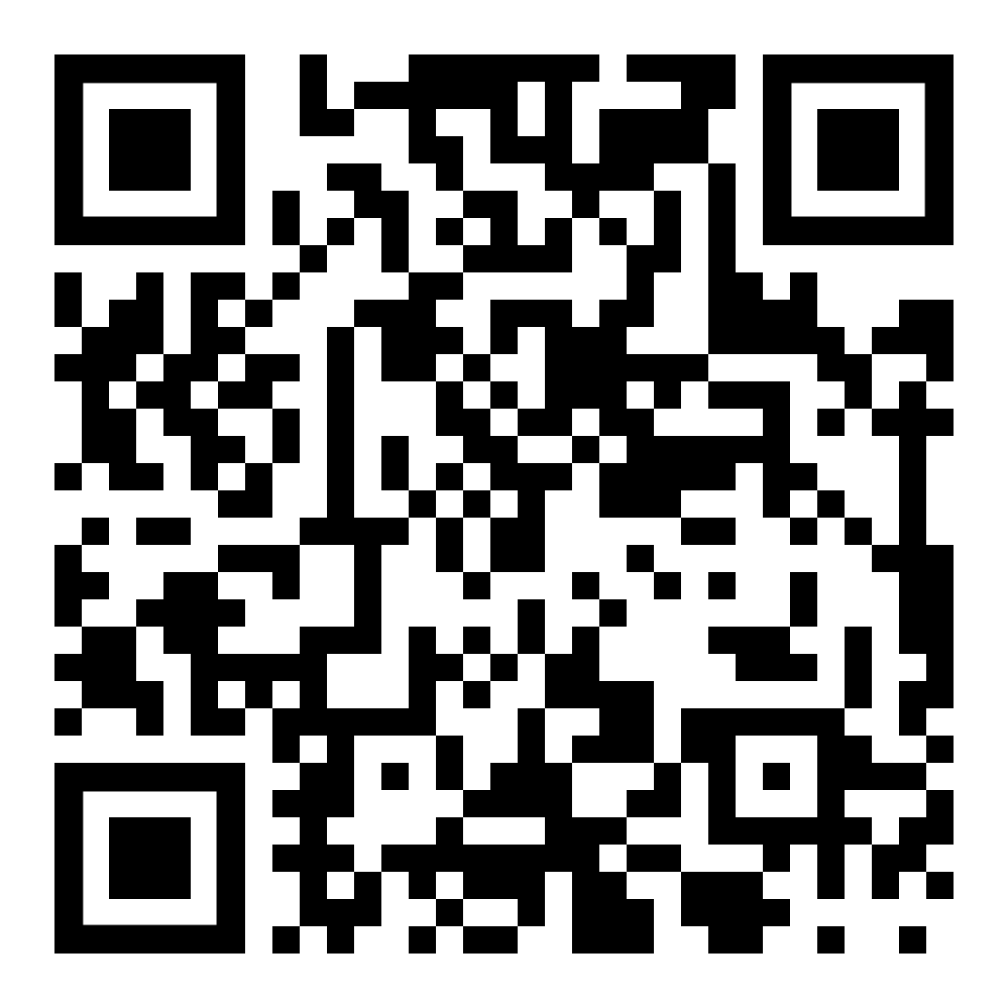
Nick B. Nicholaou, with Jonathan Smith
Church IT, 3rd Edition https://store.churchlawandtax.com/church-it/
The book covers timely, relevant topics, including:
Staffing strategies such as outsourcing and volunteers
Processes for selecting hardware and software
Approaches to WiFi, disaster recovery, monthly maintenance tasks, and security
Ways AI can strengthen ministry
Order Here!

Slide 12
Thank you

