Slide 1
CHURCH FRAUD:
WHAT TO KNOW AND HOW TO PREVENT IT
A webinar presented by:
Vonna Laue
CPA
Matthew Branaugh Attorney and Editor, Church Law & Tax

Slide 2
OVERVIEW
Reality of Fraud in the Church
Fraud Triangle
How to Prevent it

Slide 3
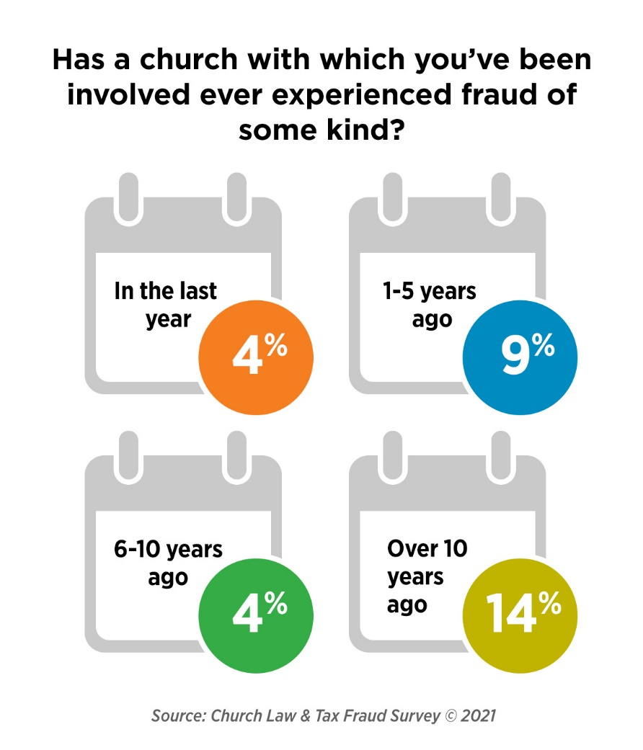
IS CHURCH FRAUD REAL?

Slide 4
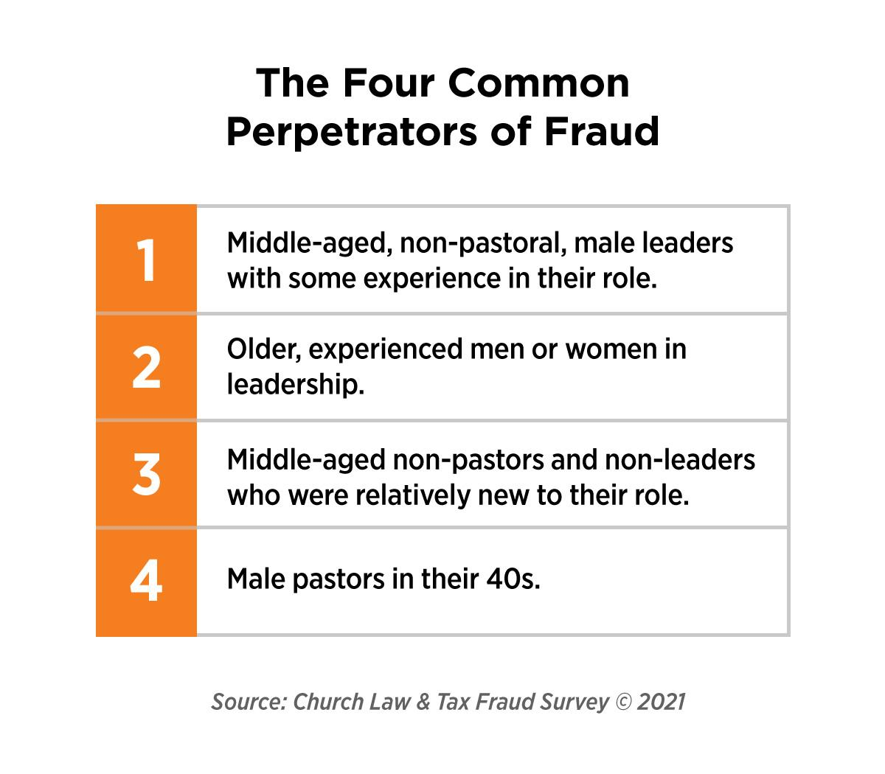

Slide 5
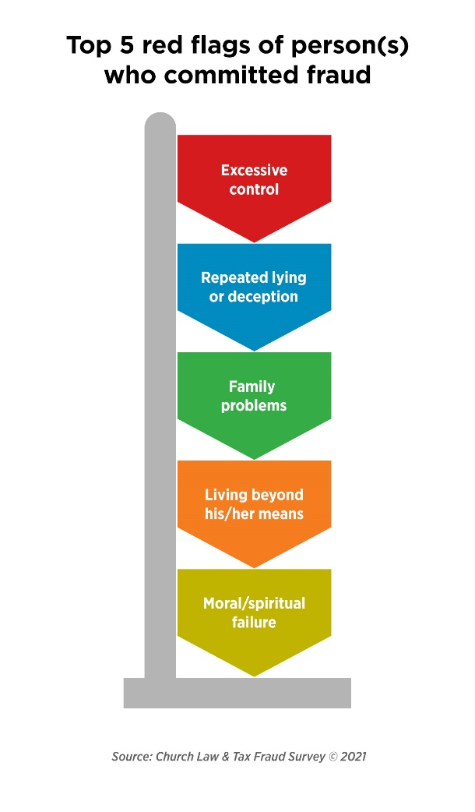

Slide 6
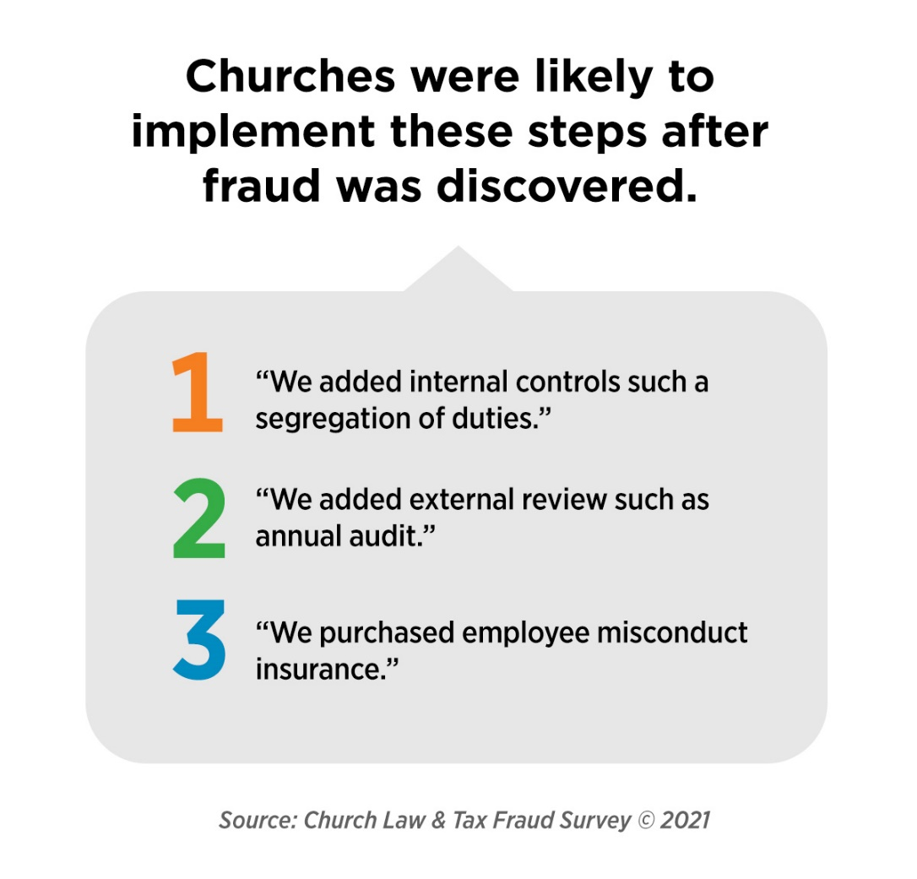

Slide 7
EXAMPLES

Slide 8
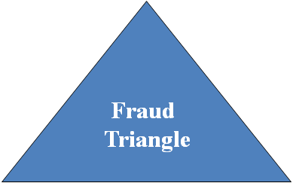
OPPORTUNITY
MOTIVATION
RATIONALIZATION

Slide 9
HOW TO PREVENT CHURCH FRAUD
Tone at the Top
Risk Assessment
Segregation of Duties
Policies - Documented and Followed

Slide 10
Q&A

Slide 11
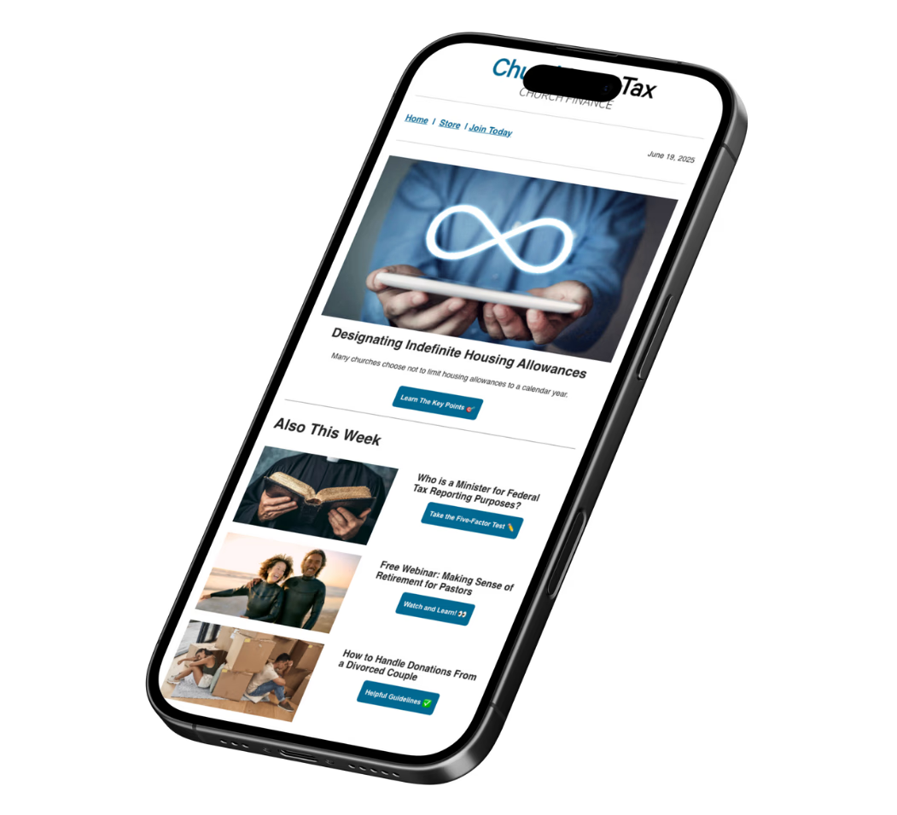
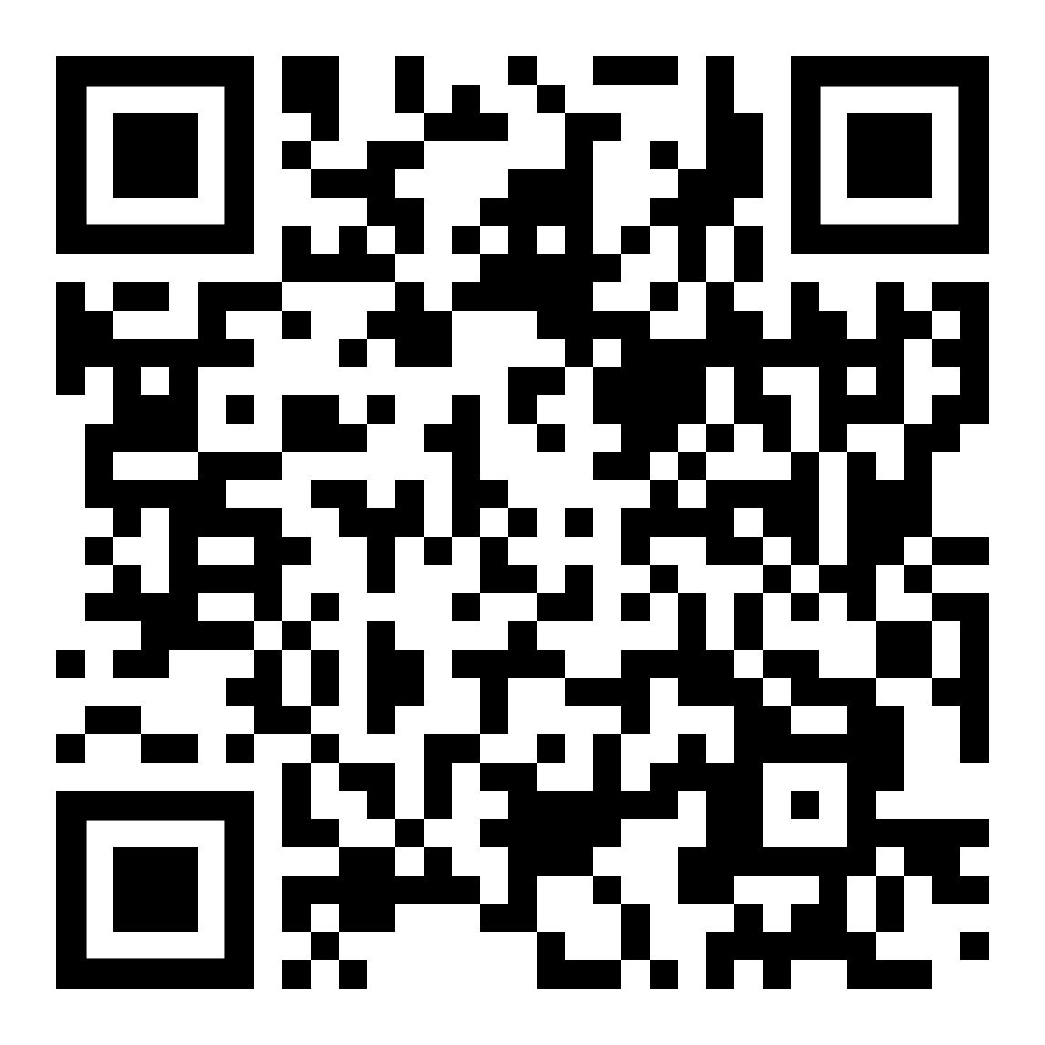
Stay Informed
Join the FREE Church Law & Tax Newsletter for trusted guidance, relevant updates, and exclusive insights, every week.

Slide 12
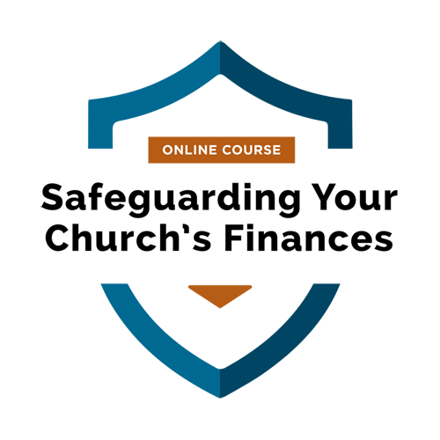
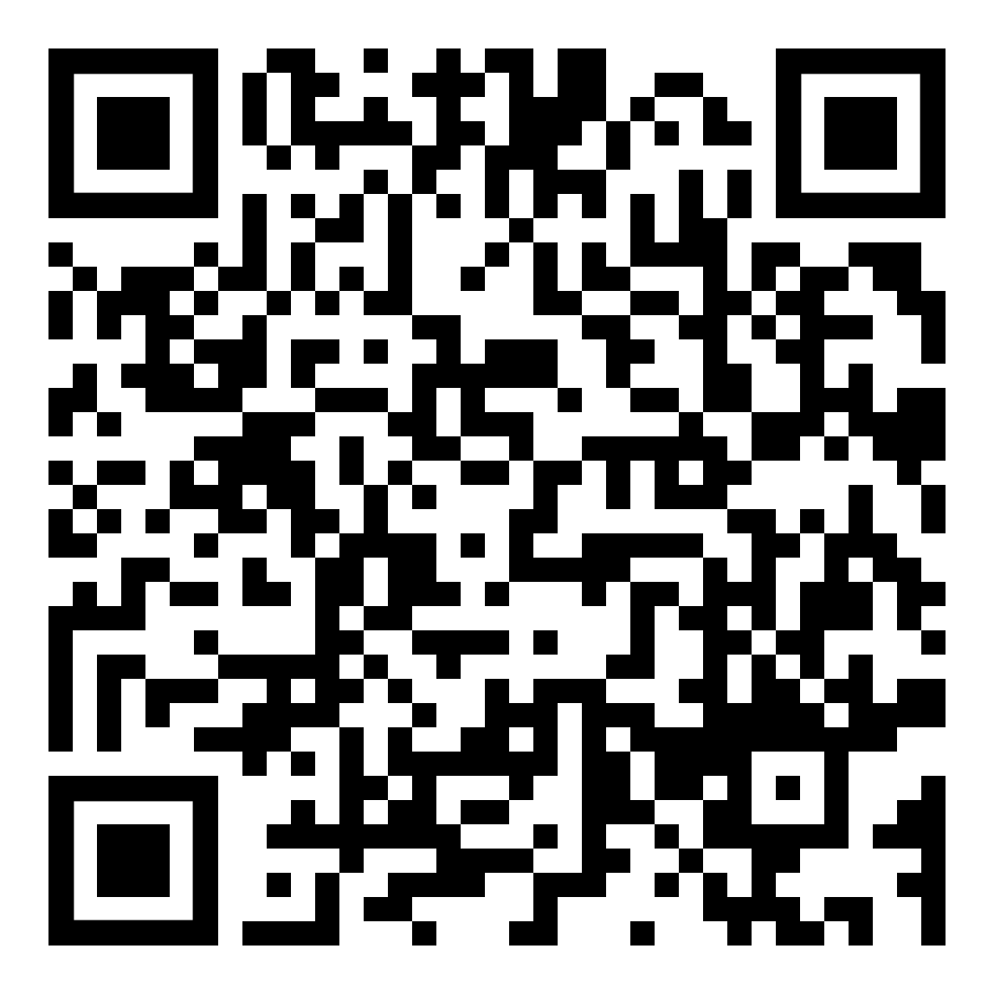
CPA Vonna Laue
Fraud Prevention Training 🔗 Enroll Now
In just a short time, you can fully train your church leadership team—including board members, pastors, senior leadership, financial staff, and volunteers—on the fundamentals to keep finances safe and secure.
Enroll Here!

Slide 13
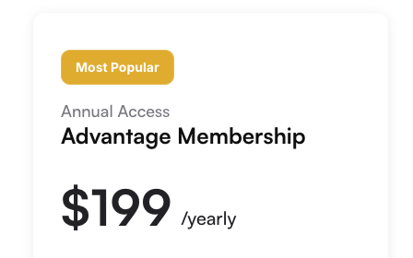
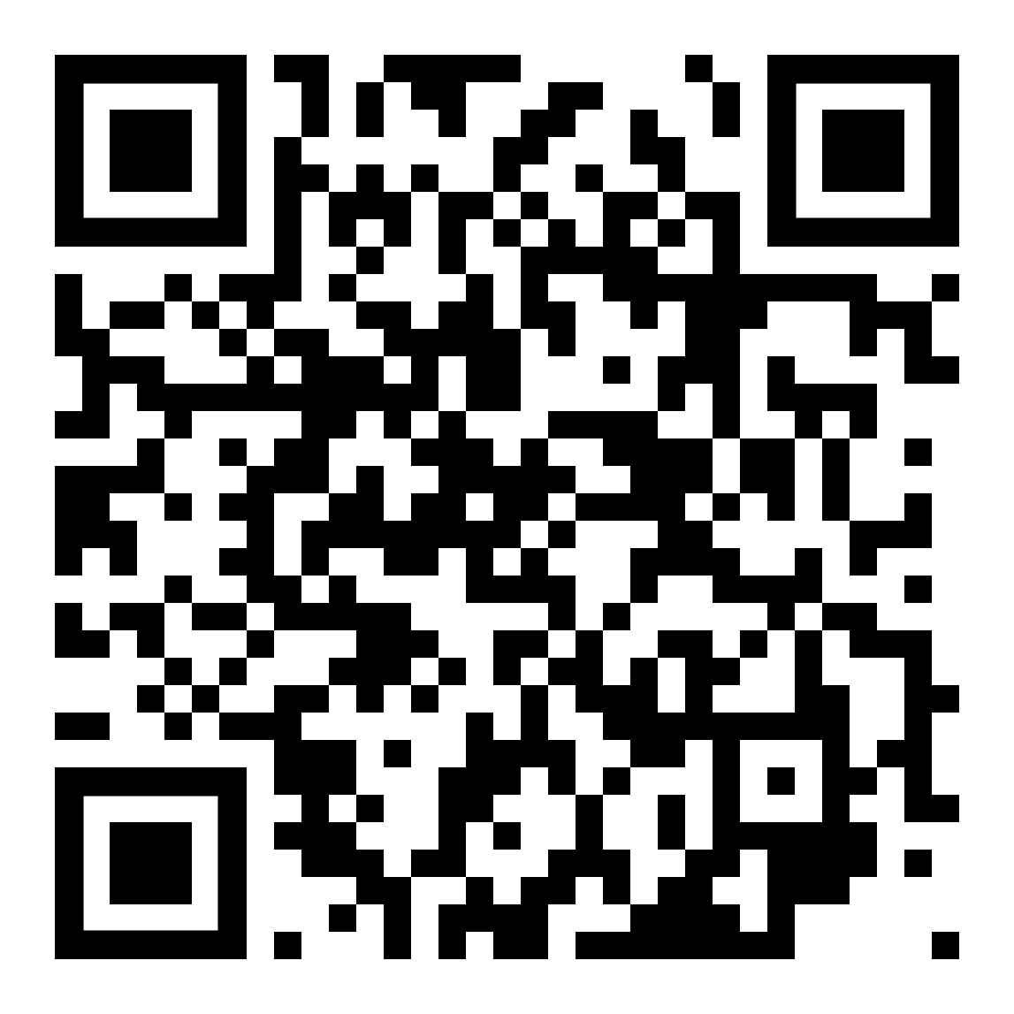
Church Law
Advantage Membership 🔗 See Memberships
Get access to the webinar recording, 2026 Tax Prep Guide for Churches and Clergy, and our new AI Chat Experience, Ask Richie.
Become an Advantage Member!

Slide 14
Thank You!
Vonna Laue
714-615-3131
vonnalaue@gmail.com

