Slide 1





Getting Agile with Your Church Budget
Kenneth Tan, Partner | Church & Denomination Services Director
September 15

Slide 2

Learning Objectives
After this session, participants will be able to:
Tie budgets to strategy, even in uncertain times
Create budget scenarios when everything is changing
Develop strategies for reducing costs

Slide 3

The Challenge
Ongoing economic changes and other unknowns create uncertainty regarding future revenue, expenses, opportunities, and challenges
Shifting priorities, strategies, tactics
This is an opportunity — and an imperative

Slide 4
Key Considerations
Don’t let ambiguity lead to inaction — act on what you know or can anticipate
Understand those changes and how they affect ministry activities and required resources
  How will changing economics impact your church (giving, minimum wage increases, interest rate changes, aging demographics, etc.)?
  What activities are stopping or starting, and what are the associated costs?
  What new infrastructure is required?

Slide 5

Budgeting Directions
Top-down
  Pros – efficient
  Cons – lack of ownership by others
Bottom-up
  Pros – buy-in and more realistic
  Cons – time-consuming and difficult to administer

Slide 6

Cash Flow Is Vital
Update cash flow forecast
As granular as required
  Budget should look at monthly cash flow
    Forecast monthly cash balances
    Monitor actuals vs. budget

Slide 7
Budget Strategies
Driven by the church’s strategic plan
  Key first step
  1 year, 2 year
  Example – Nonprofit Administration Model

Slide 8
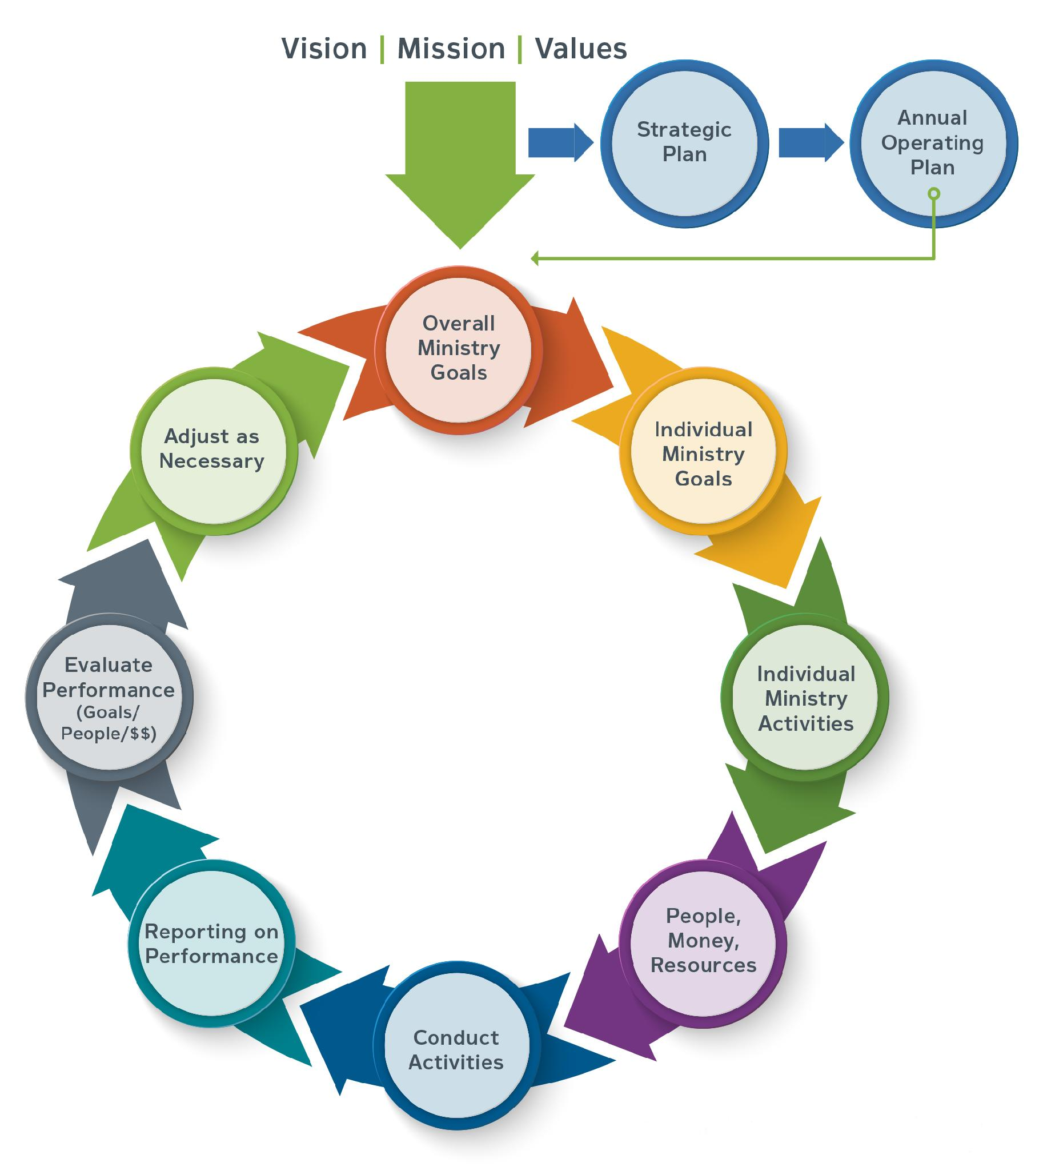
Nonprofit Administration Model
Nonprofit Administration Model
© Copyright 2020 Robert Faulk

Slide 9
What’s the Budget About? Priorities

Slide 10
Ask What Has Changed
Because of the impacts of economic changes, how have the following changed at your church?
  Strategic plan?
  Annual operating plan?
  Overall ministry goals?

Slide 11
Strategic Plan
The process of creating specific strategies, implementing those strategies, and evaluating the results of executing the plan with regard to the organization’s long-term goals or desires
Focuses on integrating various functions, such as finance, HR, development, and operations

Slide 12
Strategic Plan
At its most basic, a strategic plan identifies those factors that will make your church successful as compared to your “competitors”

Slide 13
Strategic Plan
Answers these questions:
Why will donors give to us and not others?
How will we serve our “customers” better than our competitors?
How will we satisfy our employees, members, volunteers, partners, referral sources, and others?

Slide 14
Strategic Plan– Elements to Include
Mission, vision, aspirations
Core values
SWOT analysis
Objectives (long-term goals)
Strategies, including fundraising strategies
Measurements (key performance indicators (KPIs), other key measurements)
Financial analysis (high-level)

Slide 15
Annual Operating Plan
Establishes the goals, activities, and budgets for each part of the organization for the coming year
Links the strategic plan, the activities the church will deliver, and the resources required to deliver those activities

Slide 16
Annual Operating Plan
Questions it Answers
Who should be working on what?
How will resources be acquired and allocated?
What risks do we face?
How can we mitigate the risks?

Slide 17
Annual Operating Plan
Three Important Characteristics
Appropriate level of detail
Allows for periodic reporting on progress
Linkage to strategic plan is clear

Slide 18
Annual Operating Plan
What Is Included
Answers the questions: who, what, when, and how?
  Overall ministry goals (annual objectives) – what
  Tactics – who, when, and how
KPIs

Slide 19
Annual Operating Plan
What Is Included
Financial forecasts/budgets/human and other resources
Timetables
Identify risks and responses
Process for monitoring progress

Slide 20
Individual Ministry/ Departmental Goals
Must support and align with overall ministry goals
SMART goals
How many?

Slide 21
Goal Alignments Worksheet
Ministry: Ministry Leader:
Overall Ministry Goals
Individual Ministry Goals
How Goals Support Overall Goals/Comments

Slide 22
Individual Ministry/ Departmental Goals
What activities will each ministry/department undertake to achieve its goals?
Prioritize

Slide 23
Ministry Budget Alignment Tool
Ministry: Ministry Leader:
Key Ministry Areas
Goals for this Year
Individual Ministry Activities
What are the Obstacles?
What are the Resources?
Staffing Plan for the Budget Year
Name
Position/Role
Salary/Hours Per Week

Slide 24
Ask What Has Changed
Expenses
  Personnel?
  Technology?
  Debt costs?
  Other?
What key assumptions or drivers have changed?
Revenue
  Expected giving?
  Contracts/grants?
  Other revenue sources?

Slide 25
Fixed, Semi-fixed, Variable Expenses
Fixed
  Mortgage/rent
  Insurance, taxes
  Leases (equipment, other)
Semi-fixed
  Staff costs
  Facility, utilities, phone, etc.
What percentage of your total expenses are fixed or semi-fixed?

Slide 26
Challenge Your Assumptions
Expenses
Fixed
  Are they really fixed?
  What can be negotiated, deferred, eliminated?
Semi-fixed
  Personnel
  Employee benefits
Variable

Slide 27
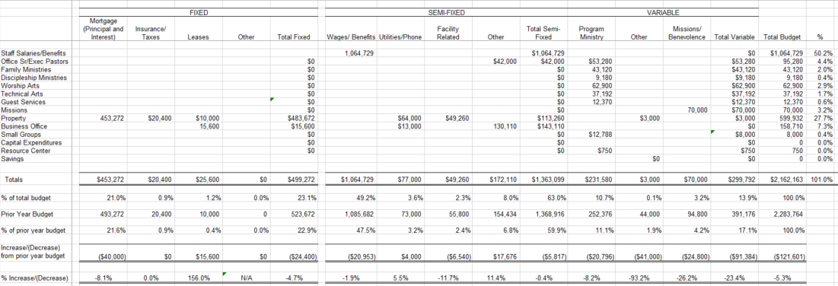
Analyze Your Budgeted Expenses

Slide 28
Don’t Do This
Ignore cash reserves
Make unrealistic income forecasts
Make across-the-board cuts
Fail to inform donors and interested parties
Let emotions drive difficult decisions

Slide 29
Do This
Communicate, communicate, communicate
Solicit input from all levels of the organization

Slide 30
Do This
Create multiple budgets
  Baseline
  Over baseline – 10%, 20%, more
  Under baseline – 10%, 20%, more
  Determine in advance triggers for additional spending/additional cuts
Monitor actuals vs. budgets regularly

Slide 31
The Revised Budget
What if the revised budget shows an unsustainable loss?
  Don’t panic
  Revisit analysis — challenge your assumptions again

Slide 32
What Costs to Cut?
Ministry-by-ministry or departmental approach
Ineffective ministries/departments – sacred cows, outdated ministries, etc.
Inefficient processes or practices
Non-strategic ministries
Personnel who aren’t performing or are in non-strategic positions

Slide 33
Maintain Perspective
Today’s challenges won’t last forever — but they will be replaced by new ones
With challenges come opportunities
Consider what your church will look like in the future
Changes now may seem painful, but when addressed correctly you will position the ministry to flourish

Slide 34
Things to Consider
Rolling budgets
Building/rebuilding cash reserves
  Target 3 – 6 months of expenses
Debt reduction strategies
Imagine and re-imagine… creativity counts
Look for operational improvements

Slide 35
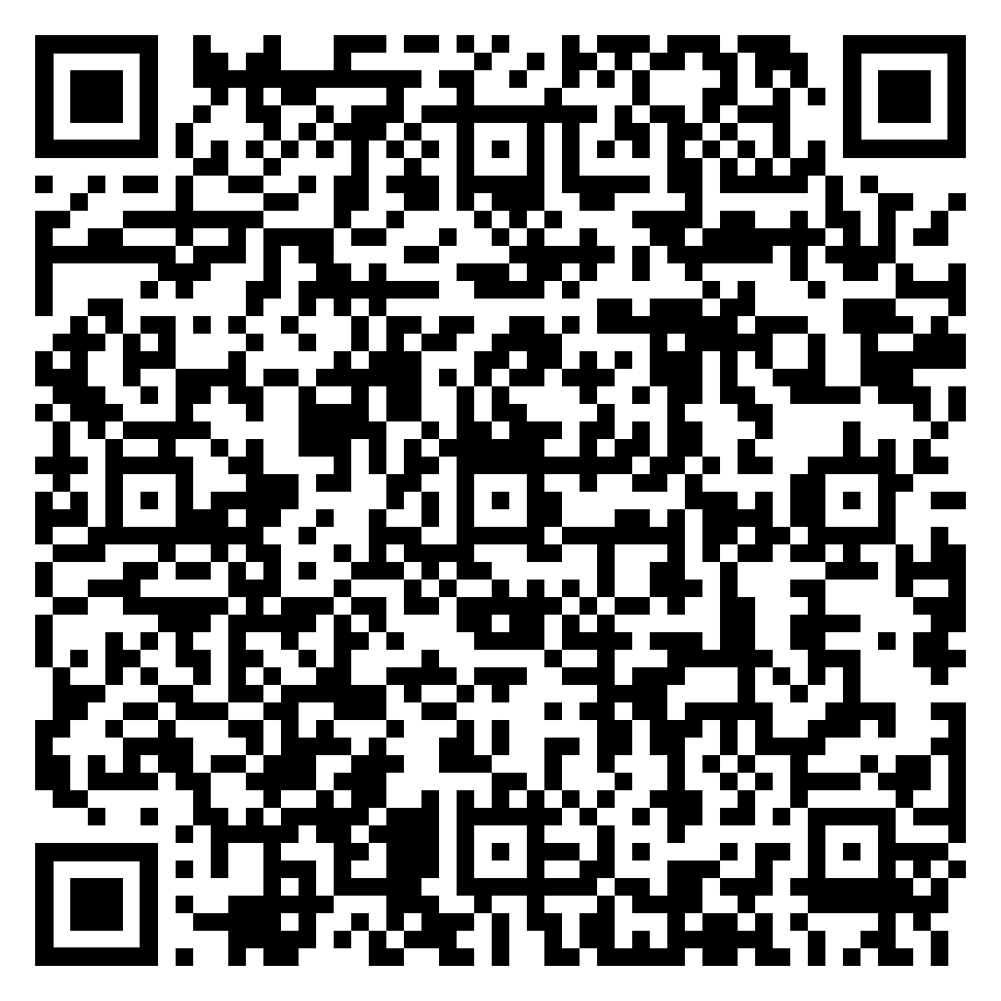
Housing Allowances
Most valuable tax benefit for ministers
Ministers propose the amount (FRV, furnished+utilities)
Board must review, approve, and document

Slide 36

AI in the Church
Christians outpace the average American with using AI
Few churches have use policies
Risks:
  Confidentiality and privacy
  Copyright and intellectual property
  Poor or inappropriate outputs

Slide 37
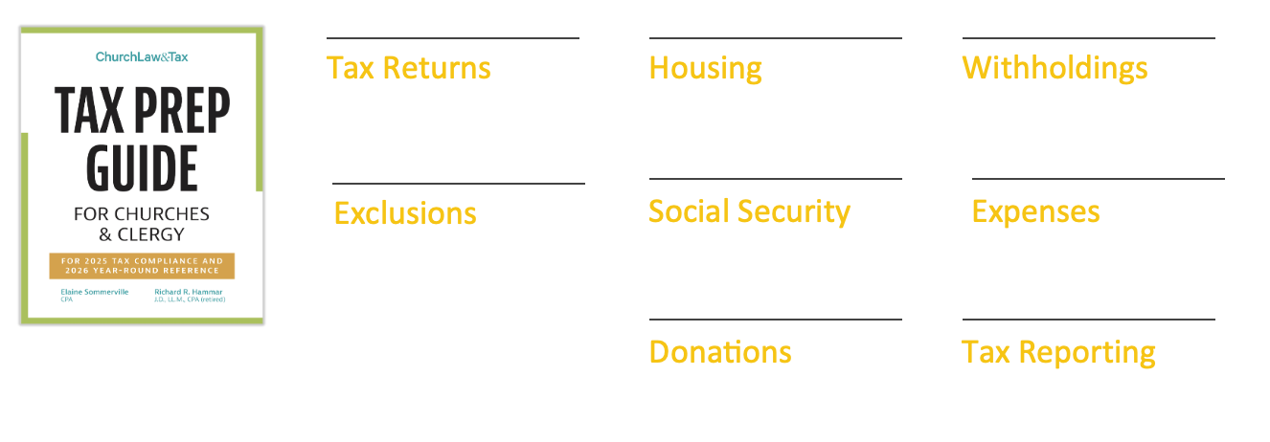
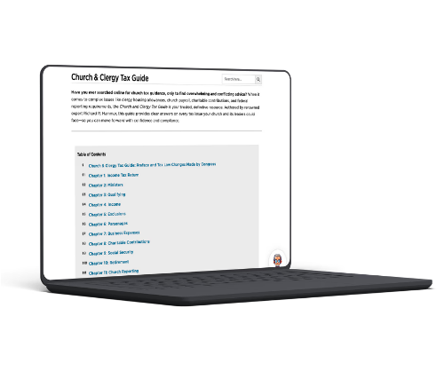
Powerful Tax Tools
Prepare and file your 2025 tax returns
Maximize your housing allowance benefits
Properly calculate how much you can withhold
Identify exclusions from gross income
Sort out social security and medicare
Correctly process business expenses
Know how to handle charitable contributions
Comply with tax reporting requirements

Slide 38

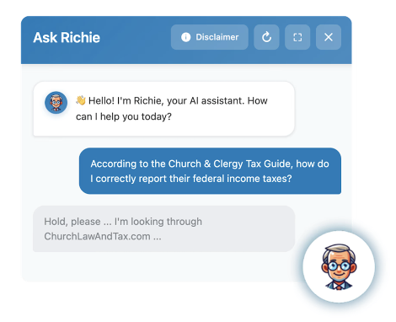

Become and Advantage Member
Become an Advantage Member for AI-guided access to:
Online legal library, articles, and Q&As
Weekly e-newsletter
Child abuse reporting laws
Weekly virtual office hours
Exclusive webinars & cohorts
20% Off ALL store purchases
Online Church & Clergy Tax Guide
AI Chat Assistant & Search
… And so much more.

Slide 39
Questions?

